Slide 1
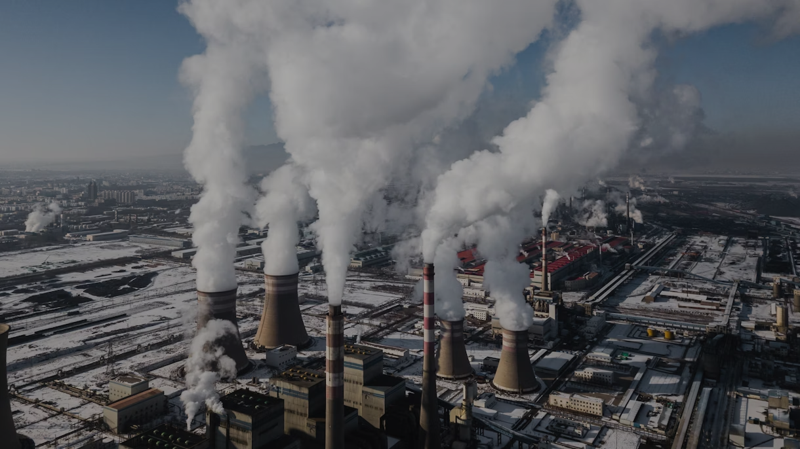

CO₂ EMISSIONS
Project 3 Team 1

Slide 2

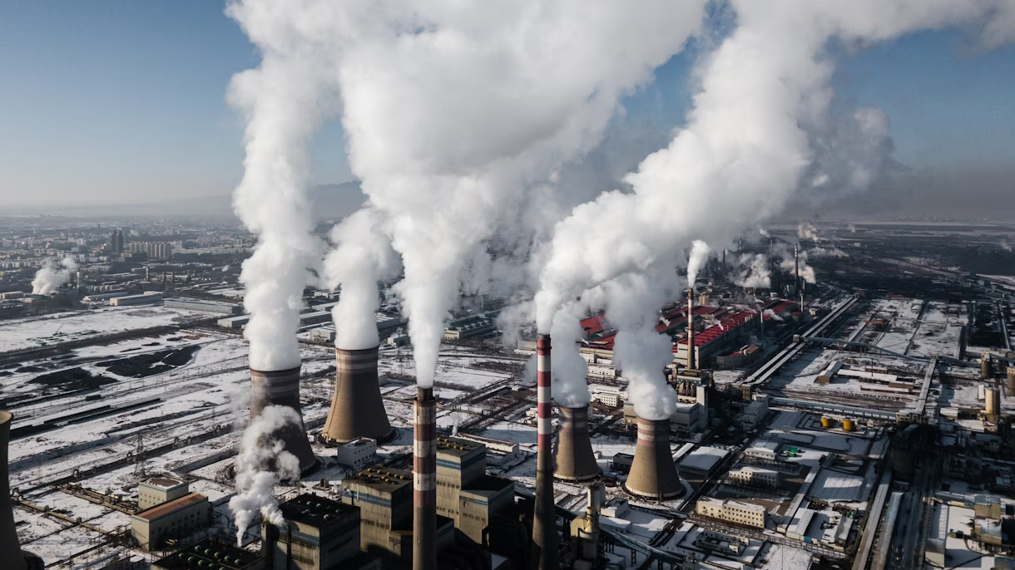
Overview
Overview and Purpose of project
Overview of statistics
Total CO₂ emissions over past 50 years
Current CO₂ emissions
Historic CO₂ emissions
CO₂ emissions per Capita 2010-2022
Impact of CO₂ emissions
Proposed solutions
Resources
03
04
05
06-10
11-17
22
23
24
25

Slide 3

Purpose of project
•Analyze the factors that contribute to CO₂ emissions.
•Compare the CO₂ emissions per country.
•Predict the impact of CO₂ emissions.

Slide 4

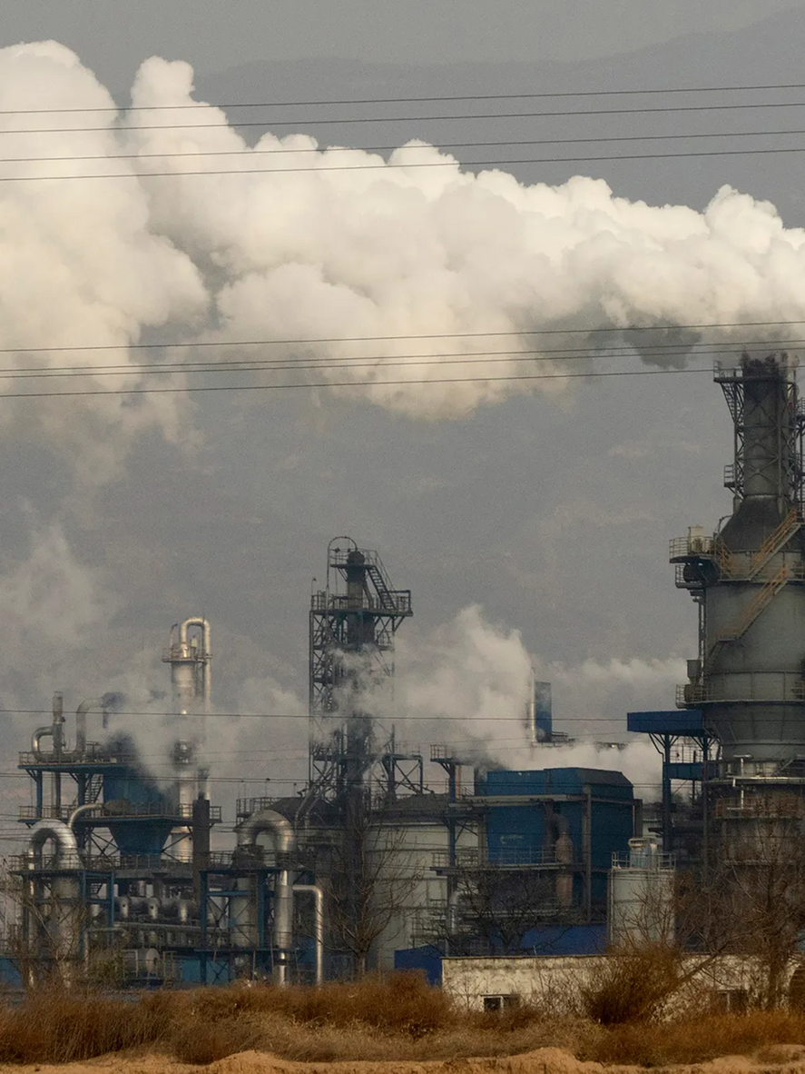
OVERVIEW OF PROJECT
Increase of CO₂ emissions over the past 30 years.
The consequences of CO₂ emissions have become more visible and severe over recent years, such as heat waves and extreme temperature rises, glaciers melting and the lowest amount of ice ever recorded in the North Pole.
Impact on climate change which led to an increase in the number of annual natural disasters

Slide 5

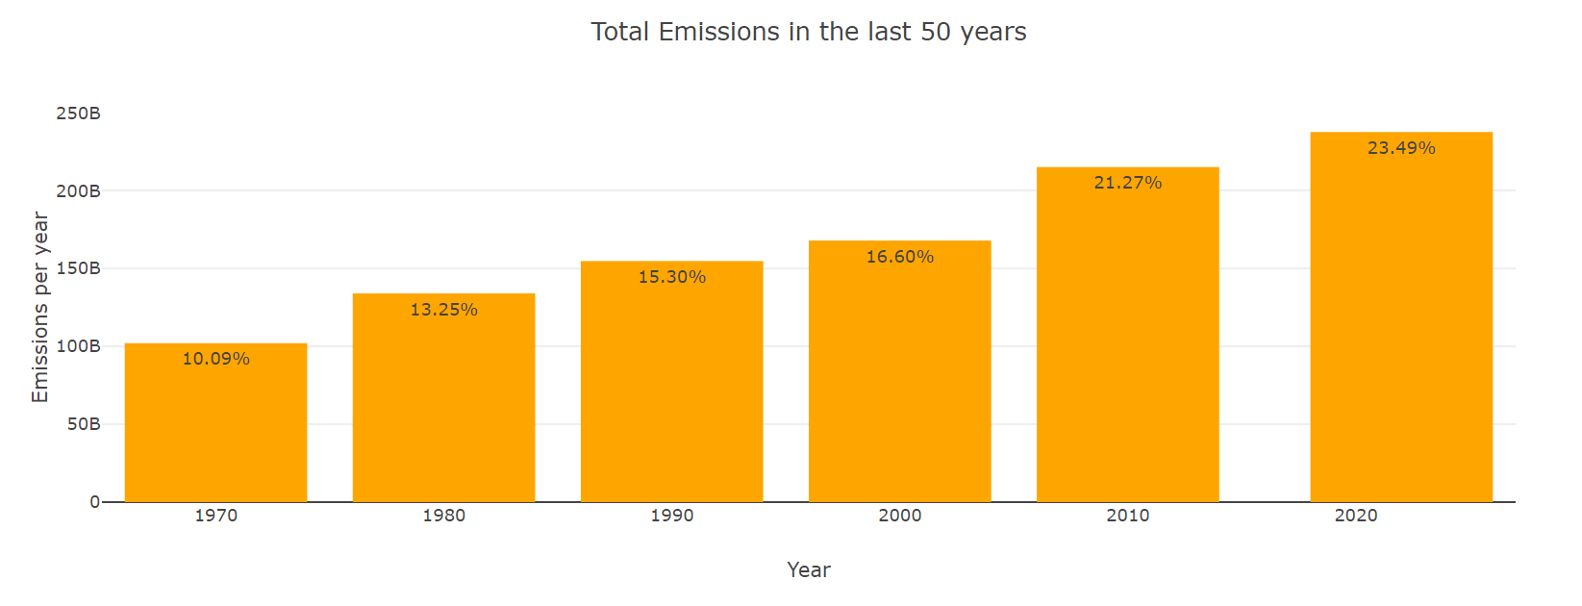
Total CO₂ emissions over past 50 years

Slide 6
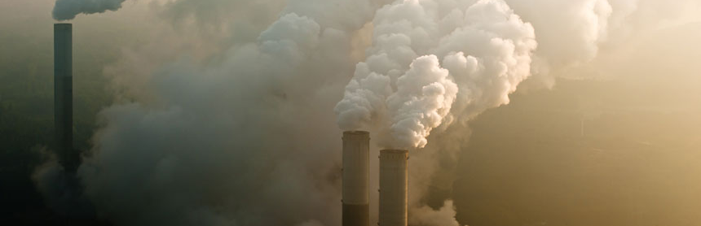
CURRENT CO₂ EMISSIONS
Which countries are responsible for the current CO₂ emissions?

Slide 7
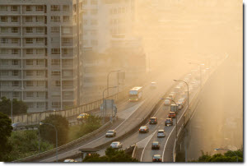

Daniel
Current CO₂ emissions
2010-2022
Although all countries agree on decreasing the CO₂ emissions to reduce the impact on climate change, they do not agree on the countries who are responsible for the CO₂ emissions.
Developed countries argue that they are making efforts to reduce CO₂ emissions and developing countries state that they are in fact survival emissions.
On the other hand, developing countries argue that the developed countries have historically already caused pollution.
Upon analysis, China ranks highest in CO₂ emissions, 11 billion tons. Followed by the United States and India.

Slide 8
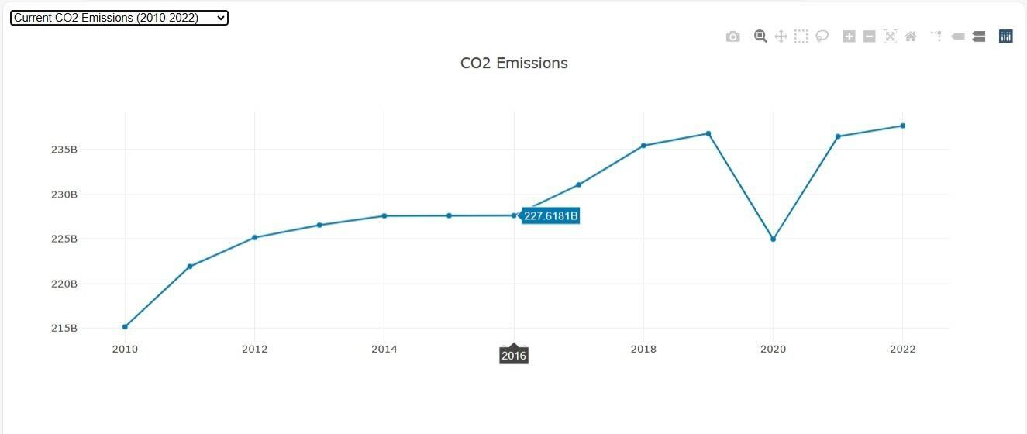
Global CO₂ emissions (2010-2022)

Slide 9
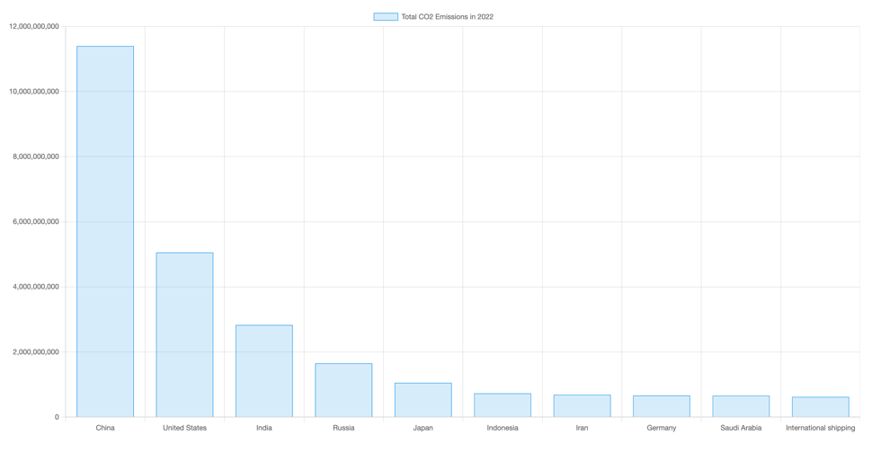
Top 10 countries emitting CO₂ from 2010-2022

Slide 10
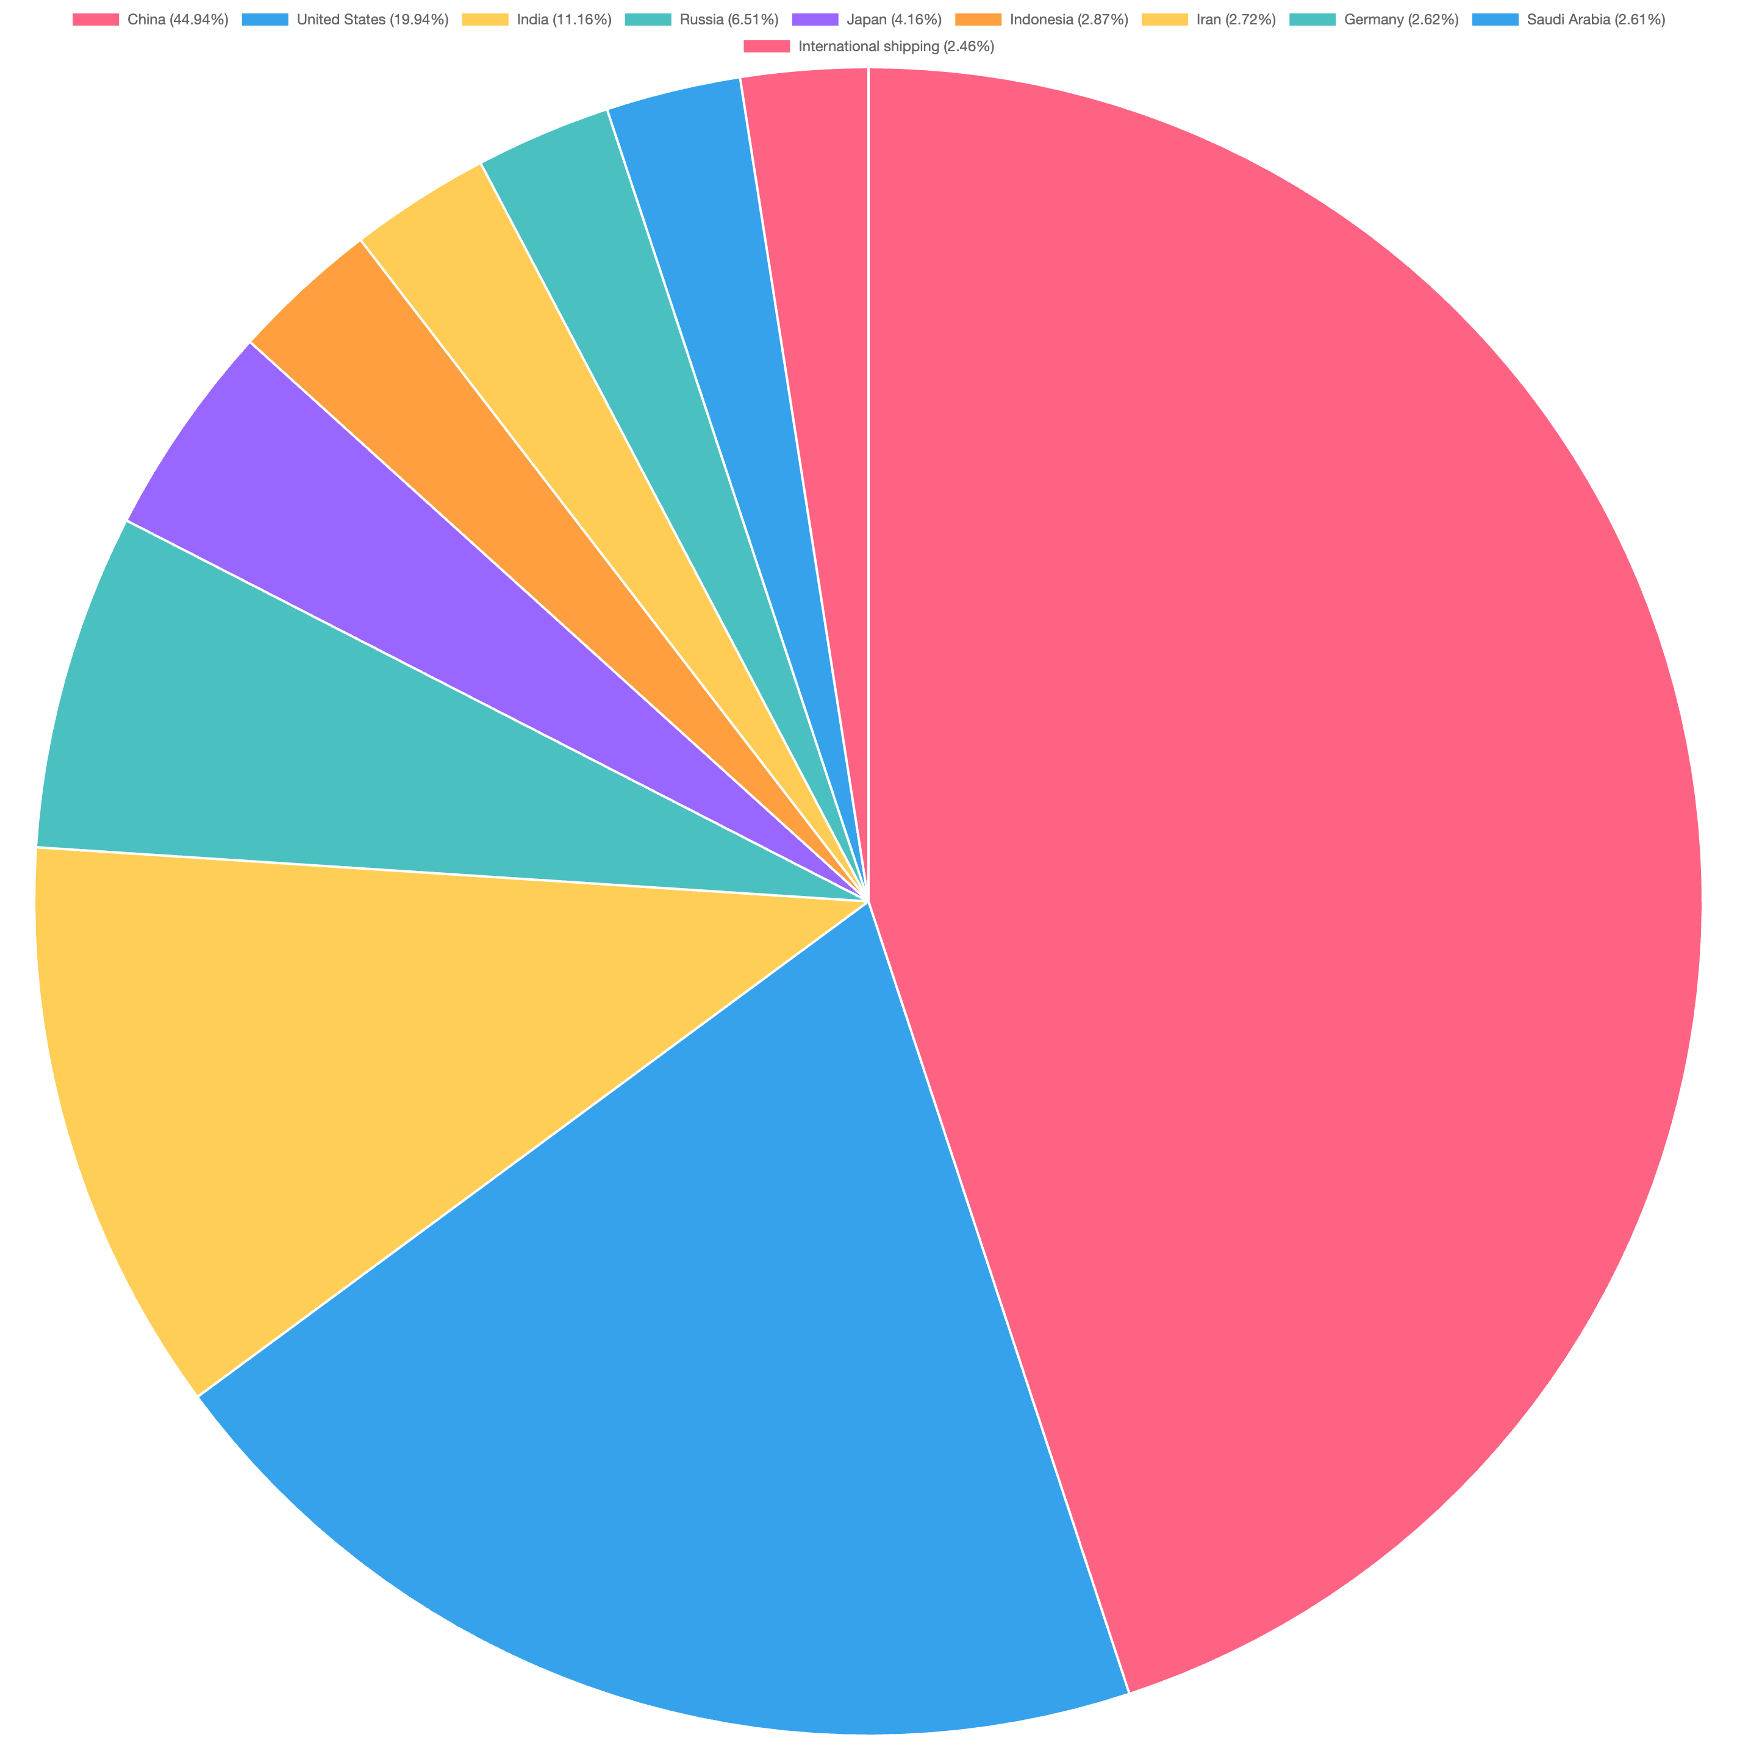

CO₂ emissions share in 2022

Slide 11


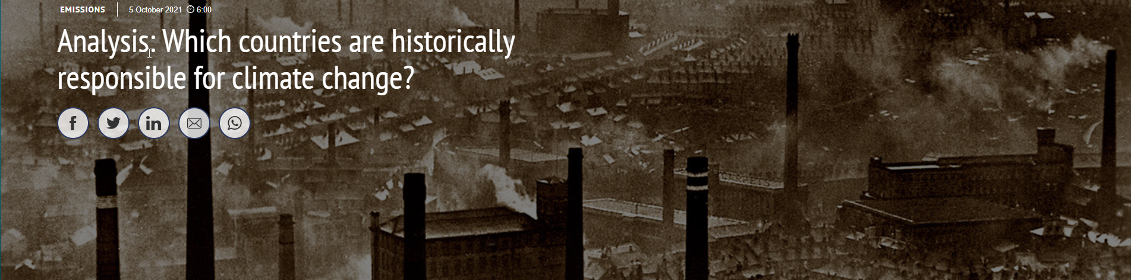
Historic CO₂ emissions
Which countries are historically responsible for the CO₂ emissions?

Slide 12

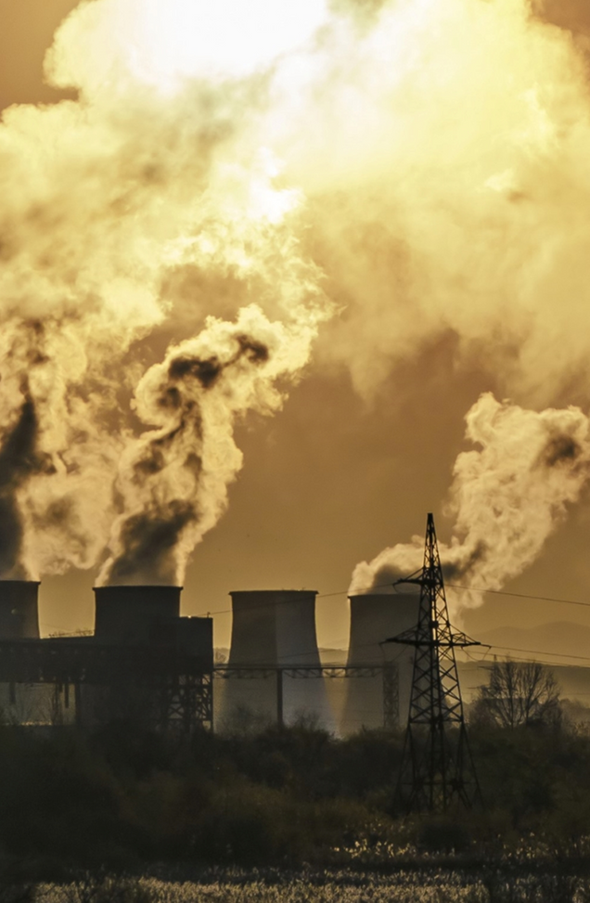

HISTORIC CO2 EMISSIONS
•It is insufficient to only look at the current CO2 emissions.
•From the chart, we can tell that the USA ranked highest on the CO2 emitting countries, followed by the European Union.
•From the historic data from 1960-1980, we can see that the United States and the countries in the European Union have historically emitted more CO2 emissions than China.
•In the 20th Century, the United States has emitted around 20 billion tons of CO2 emissions.
If we look at emissions throughout history until today, the outlook changes drastically.
• The US and EU both knock China off the top spot.

Slide 13
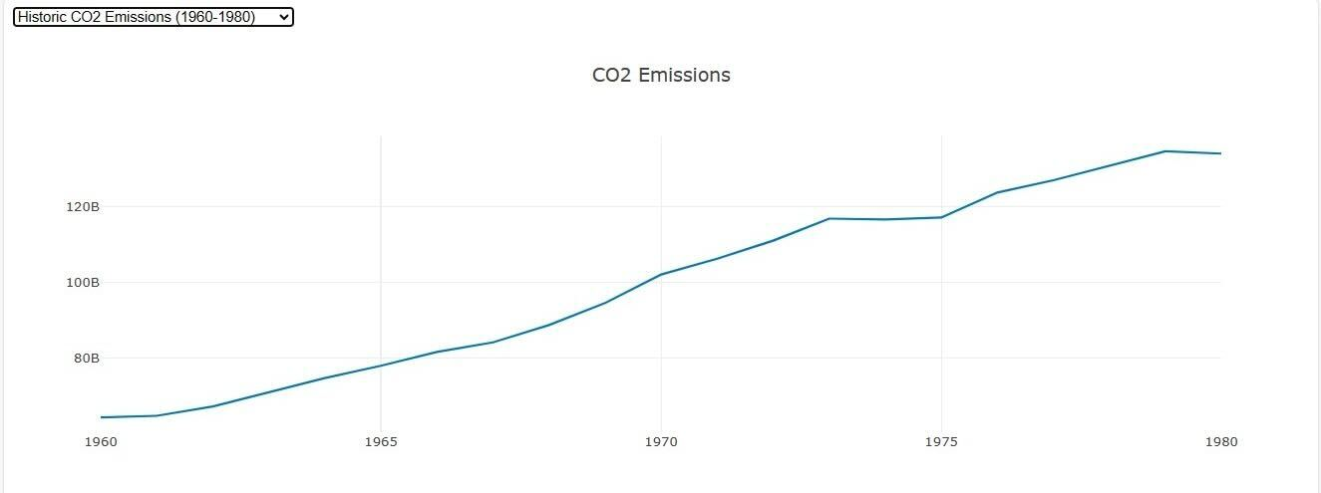
Annual CO₂ emissions worldwide from 1960 to 1980
Notes:
the US is responsible for 25% of the worlds historical emissions emitting 400 billion tons, mostly in the 20th century.
In 2nd place is the EU at 22%, China comes in third at just under 13%, around half of the USA's contribution.
India's contribution shrinks to 3 percent along with the whole of Africa and South America.

Slide 14
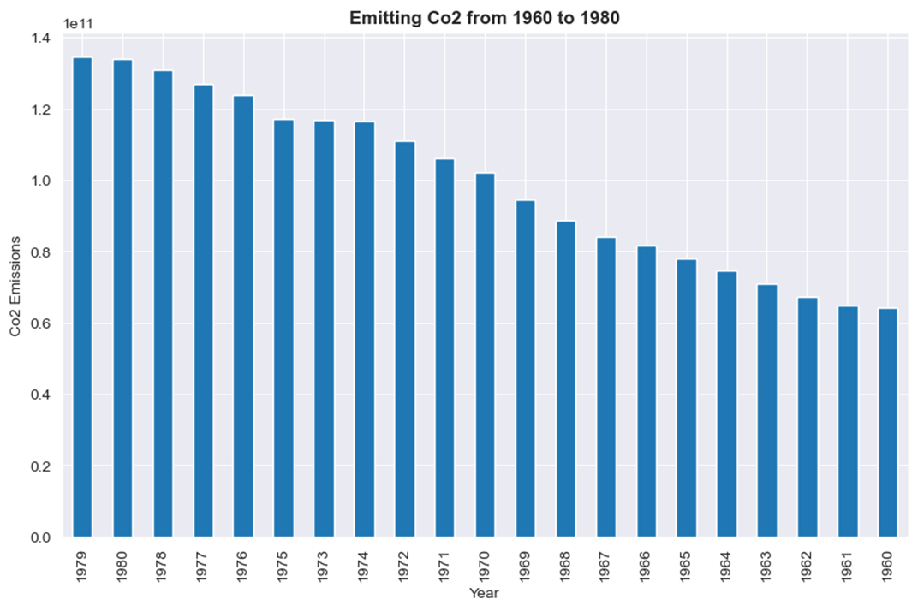
Cumulative CO₂ emissions from 1960-1980

Slide 15
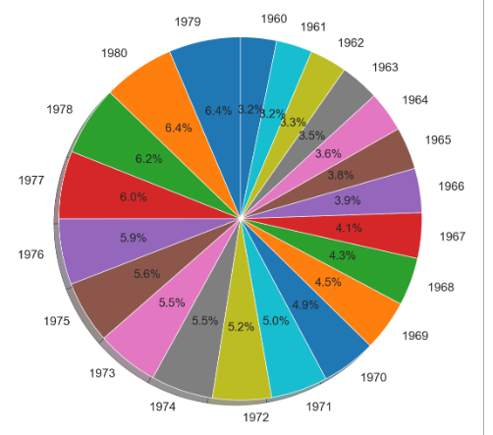
Global annual CO₂ emissions between 1960-1980
Notes:
the US is responsible for 25% of the worlds historical emissions emitting 400 billion tons, mostly in the 20th century.
In 2nd place is the EU at 22%, China comes in third at just under 13%, around half of the USA's contribution.
India's contribution shrinks to 3 percent along with the whole of Africa and South America.

Slide 16
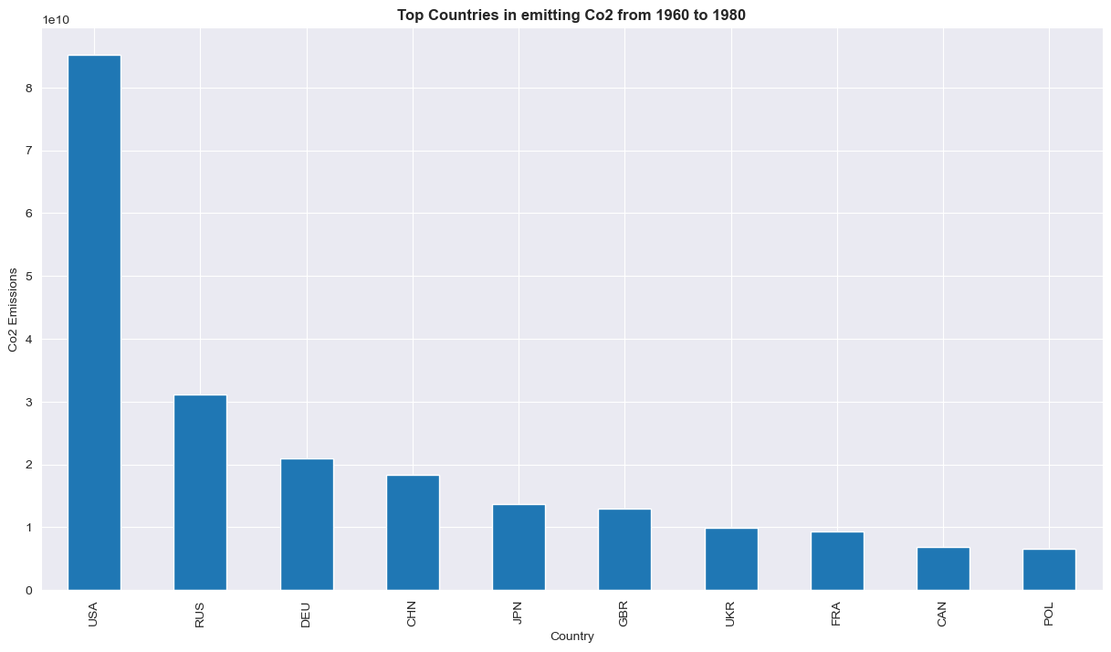
Top 10 countries emitting CO₂
Historic data from 1960-1980
Notes:
the US is responsible for 25% of the worlds historical emissions emitting 400 billion tons, mostly in the 20th century.
In 2nd place is the EU at 22%, China comes in third at just under 13%, around half of the USA's contribution.
India's contribution shrinks to 3 percent along with the whole of Africa and South America.

Slide 17
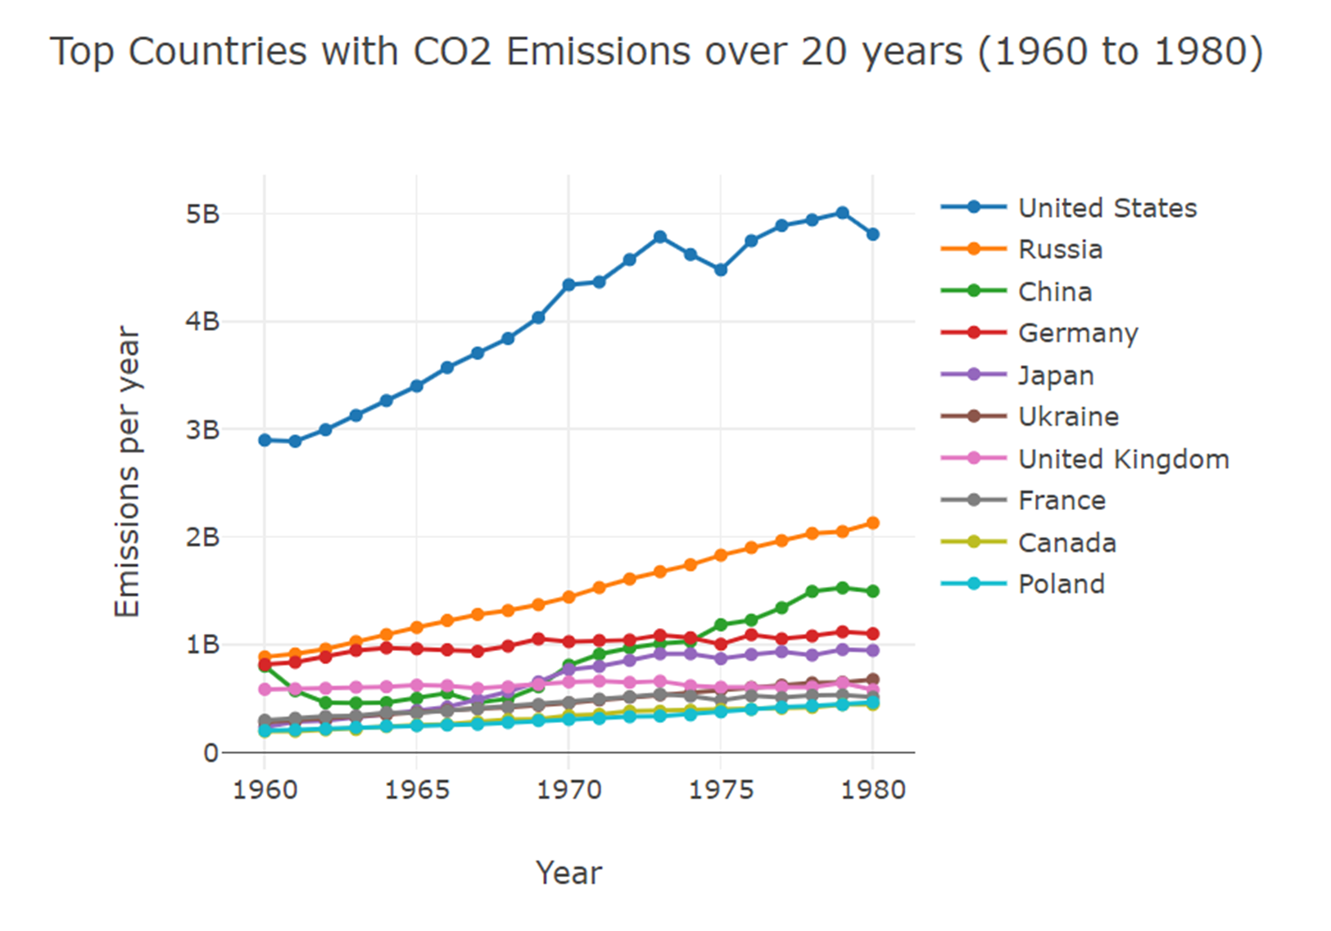
Historical CO₂ emissions worldwide between 1960-1980
The UK is responsible for 1% of annual global emissions but takes 5% of the historical responsibility.
Germany produces 2% of emissions per year today, has contributed almost 6% as much as the whole Africa and South America combined.
Notes:
So the narrative that rapid climate change is really the responsibility of the developing world is hard to defend if facts matter to you. But this is still not the whole story, because focusing on countries mixes two things:
Population numbers and total emissions. if a country has more people in general, it's emissions are of course higher.

Slide 18

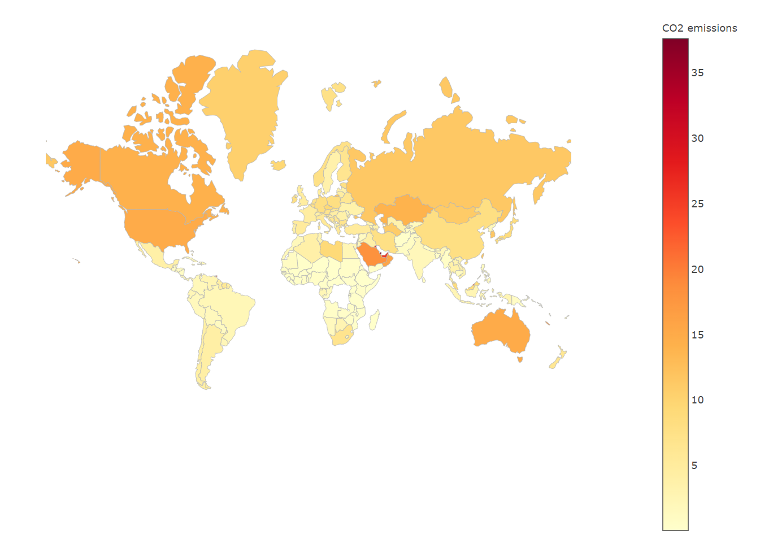
CO₂ emissions per capita
Which countries have the highest CO₂ emissions/person?

Slide 19
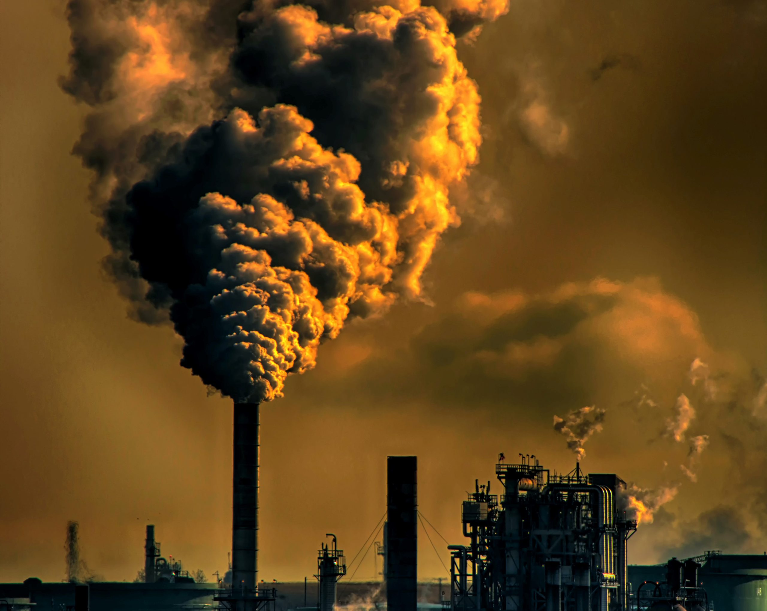
CO₂ emissions per Capita 2010-2022
•The average human is responsible for 5 tons of CO₂ emissions/year.
•The numbers varies based on individuals from different countries. For example, the population in the oil producing countries have higher CO₂ emissions.
•Qatar is the top country which has the highest CO₂ emissions. They emit around 37 tons/year.
•Wealth is one of the strongest indicators of carbon footprint.
• As individuals accumulate wealth, they also gain access to modern technologies.
•The wealthiest half of the countries are responsible for 86% of global emissions. The bottom half only contribute to 14% of the global emissions.

Slide 20
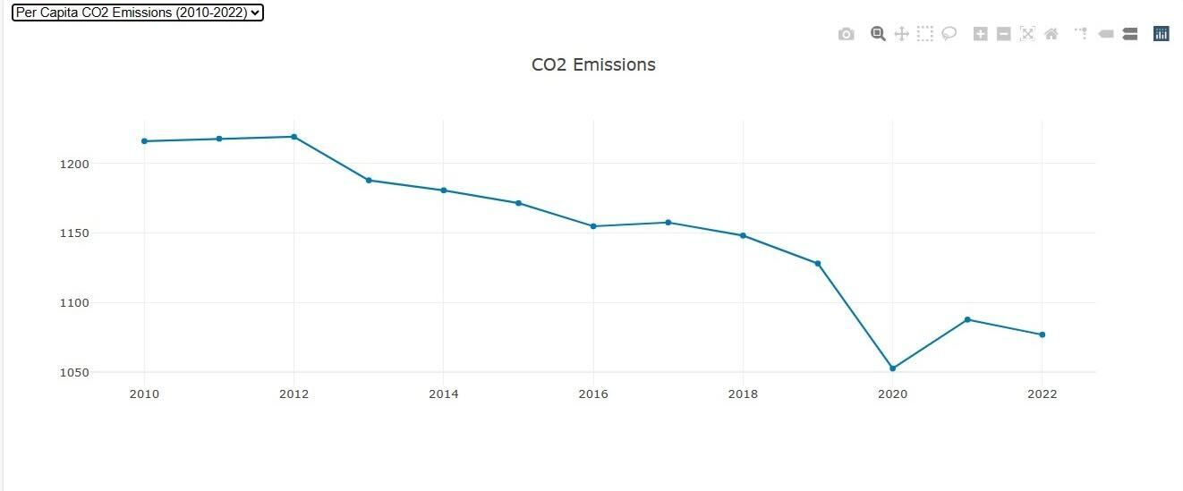
CO₂ emissions per capita
between 2010-2022

Slide 21
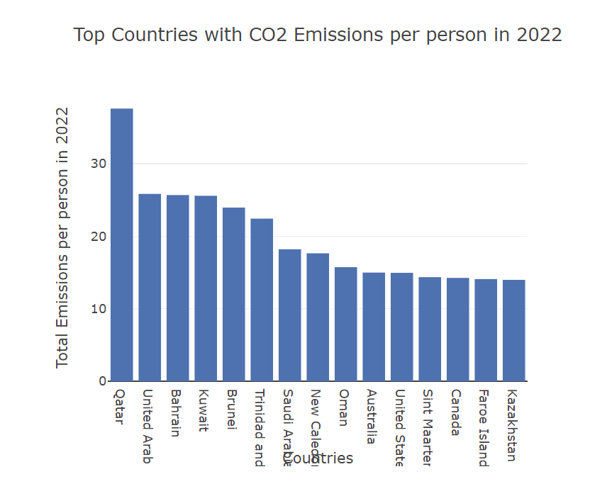
Top 15 countries with CO₂ emissions/person in 2022

Slide 22
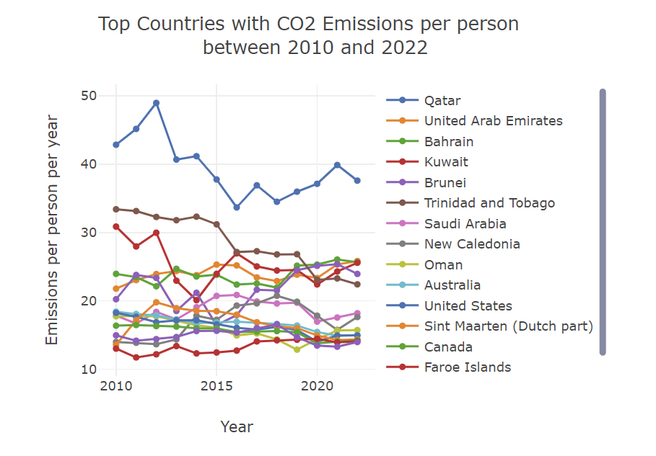
Top 15 countries emitting CO2/person
between 2010-2022

Slide 23
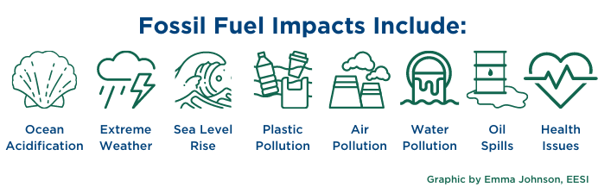

Impact of CO₂ emissions
•Developing countries will be hit the hardest from the consequences of CO₂ emissions leading to conflict over resources, food insecurity, an increase natural disasters and climate refugee movements.

Slide 24

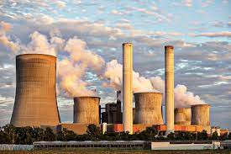
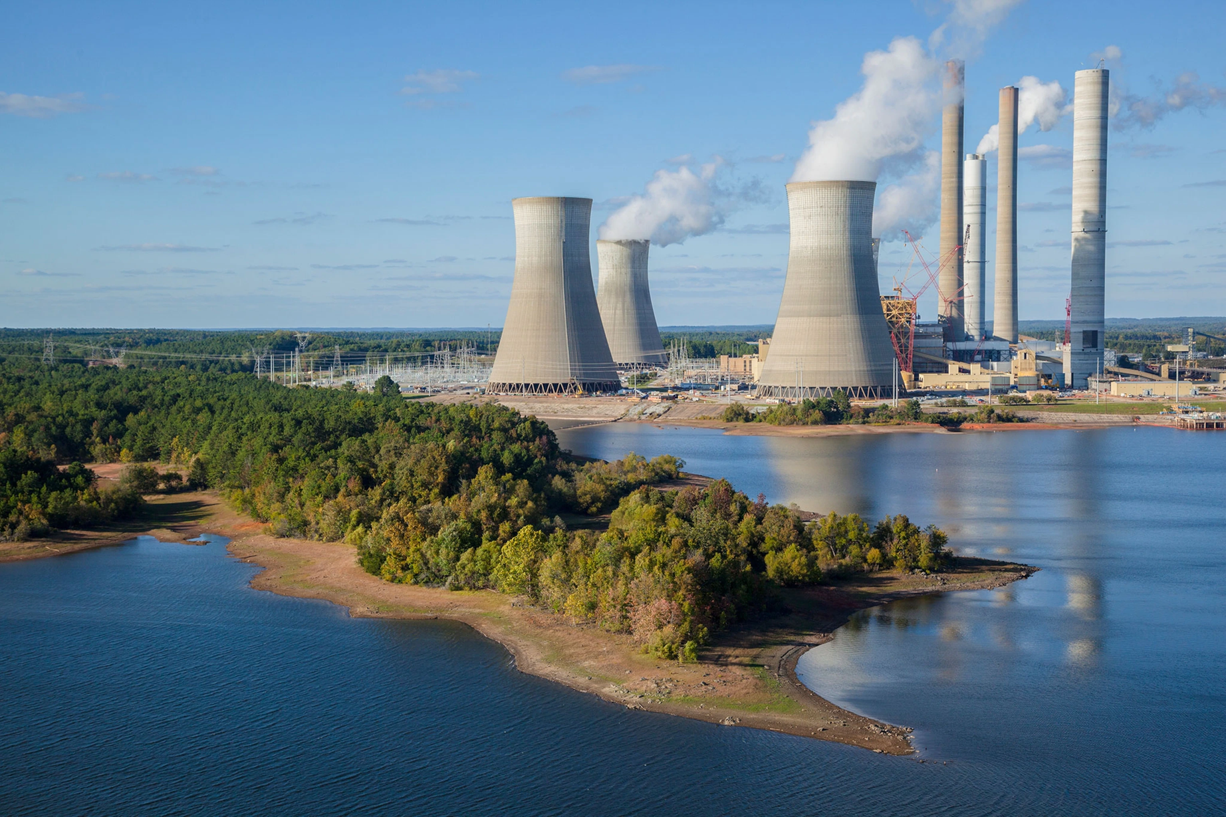
Proposed solutions
•At the core of transforming our energy systems and industries to reduce carbon emissions, we need to resolve the energy poverty, low standards of living, and poor nutrition in developing countries.
• The richest countries have access to the resources, highly educated workforce and technology to develop low cost, low carbon solutions and spread them around the world.
•If we don’t want developing countries to follow the high-carbon pathway of developed countries and become as fossil fuel dependent as the developed countries, then clean energy technologies must be affordable and accessible.

Slide 25
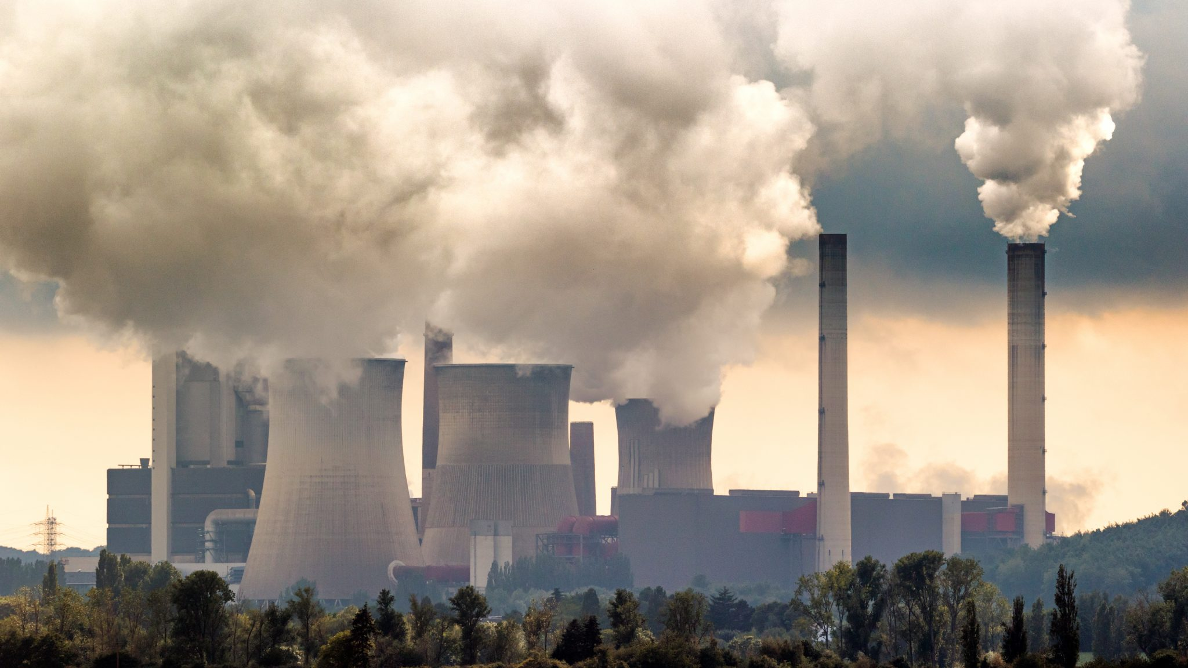
Ressources
• Bertrand, Savannah. (2021, December 21). Fact Sheet | Climate, Environmental, and Health Impacts of Fossil Fuels (2021) . Environmental and Energy Study Institute. https:/https://www.eesi.org/papers/view/fact-sheet-climate-environmental-and-health-impacts-of-fossil-fuels-2021
• Carbon Brief. (October 5, 2021). Analysis: Which countries are historically responsible for climate change? . Carbon Brief. www.carbonbrief.org/analysis-which-countries-are-historically-responsible-for-climate-change/
•Hannah Ritchie, Pablo Rosado and Max Roser (2023) - “CO₂ and Greenhouse Gas Emissions” Published online at OurWorldInData.org. Retrieved from: 'https://ourworldindata.org/co2-and-greenhouse-gas-emissions' [Online Resource]
• Hansen, Michael. (2021, February 11). ALMOST 9 MILLION DEATHS CAUSED BY FOSSIL FUEL POLLUTION. Gasp. https://gaspgroup.org/almost-9-million-deaths-caused-by-fossil-fuel-pollution/.
•Kurzgesagt – In a Nutshell. (2020, June 21). Who Is Responsible For Climate Change? – Who Needs To Fix It? [Video]. Youtube. https://www.youtube.com/watch?v=ipVxxxqwBQw
•Neill, Pippa. (2020, February 12). Air pollution from fossil fuels costs the global economy $8bn a day. Air quality news.com. https://airqualitynews.com/industrial/air-pollution-from-fossil-fuels-costs-the-global-economy-8bn-a-day/
• SIMMONS, RASHAD. (2023, March 3). Global carbon dioxide emissions reached new highs in 2022: report. The Hill. https://thehill.com/policy/energy-environment/3882651-global-carbon-dioxide-emissions-reached-new-highs-in-2022-report/
• Suzuki, David. (2023, April 12). COLUMN: Who pays the hidden, exhorbitant costs of fossil fuels. Rossland Telegraph. https://rosslandtelegraph.com/2023/04/12/column-who-pays-hidden-exhorbitant-costs-fossil-fuels/

